Slide 1

Predicting Wildfire Severity
David Cavanaugh
Math 8670: Advanced Statistical Machine Learning
December 14, 2021

Slide 2
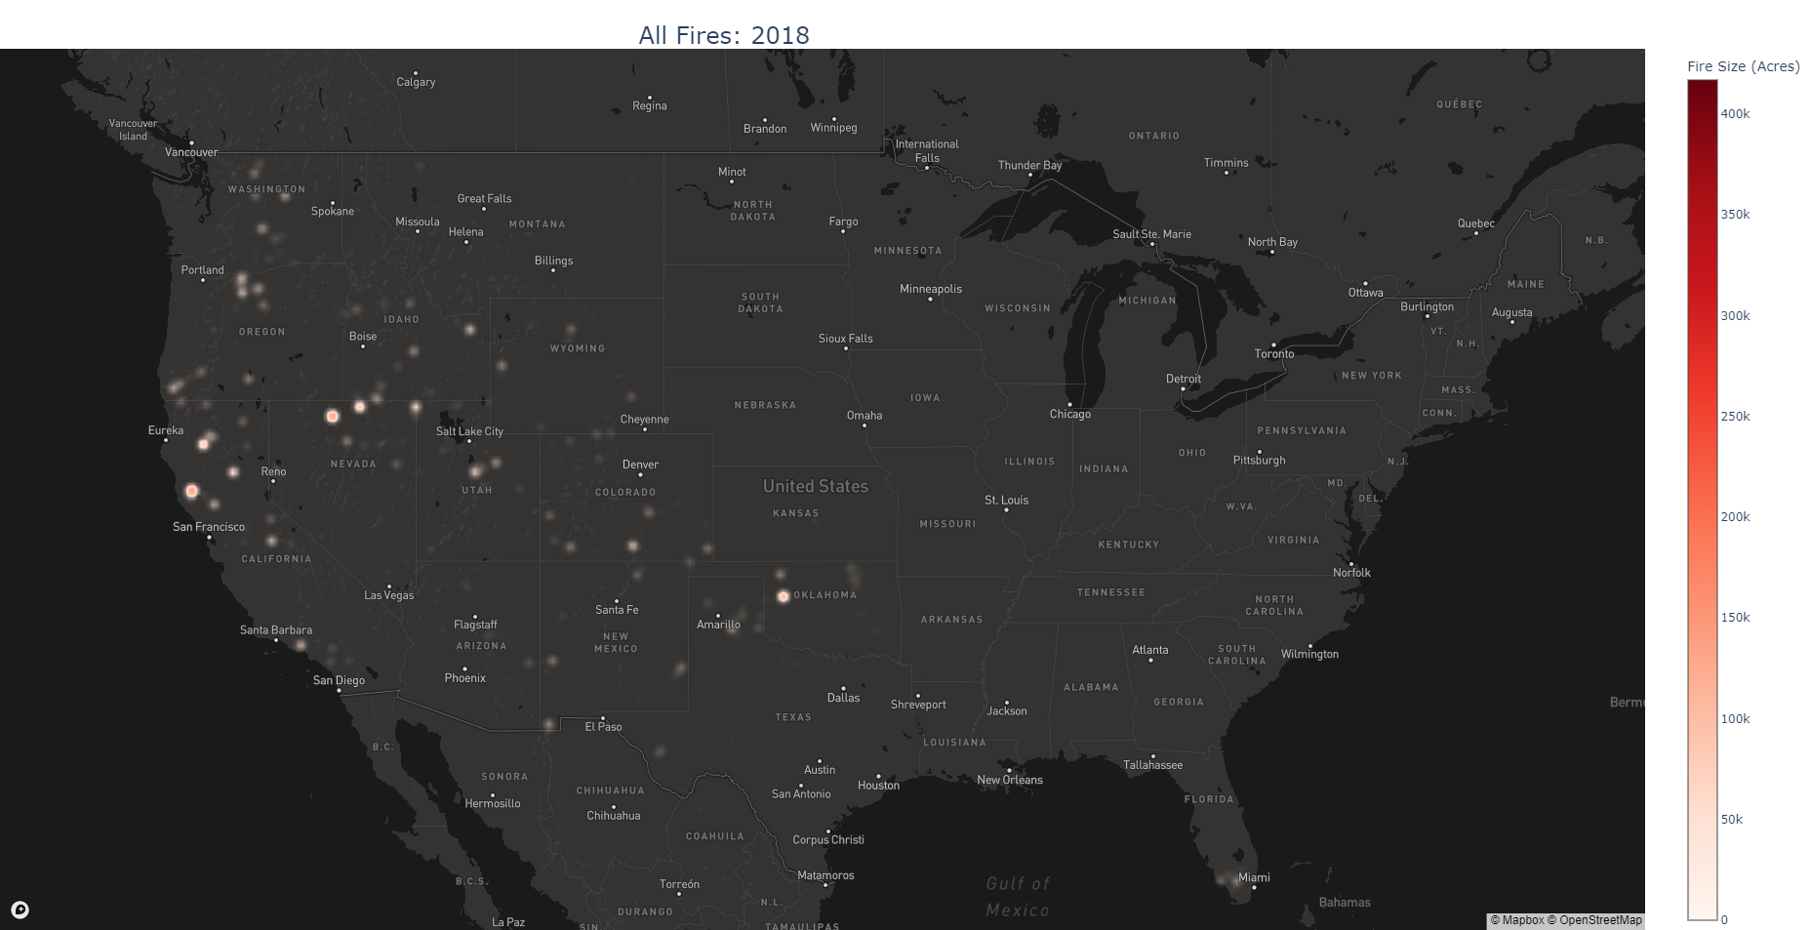
Data Overview
Data Source:
U.S. Department of Agriculture Research Data Archive
General Details
Starts in 1992, ends in 2018 (most recently published data)
Covers every state in the U.S. including Hawaii and Alaska
Geographically allocated at the State and County level

Slide 3
Additional Data
Weather Data
National Oceanographic and Atmospheric Administration (NOAA)
Precipitation, Min and Max temperature by month for select states
County Spatial Data
U.S. Census Bureau
County size in acres for all counties in U.S.
Notes:
Only considered Western U.S. States which includes Washington, Oregon, California, Idaho, Nevada, Arizona, Montana, Utah, New Mexico, Colorado and Wyoming

Slide 4
Research Question
Can we use historical fire data, in conjunction with weather and county spatial data to model the severity (size) of wildfires by month for the selected counties?

Slide 5
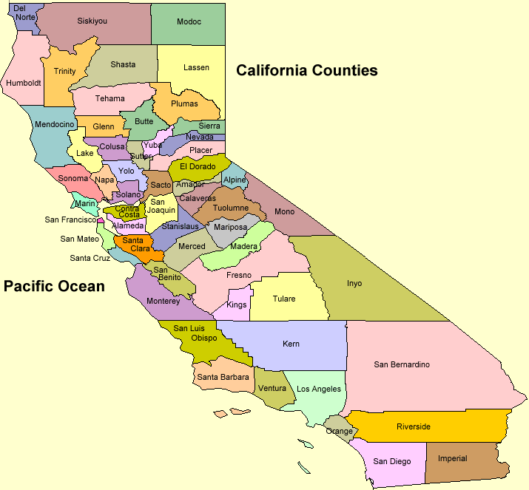
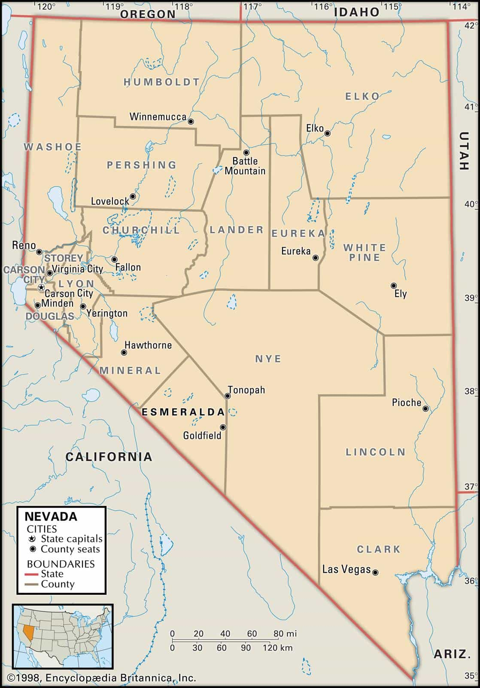
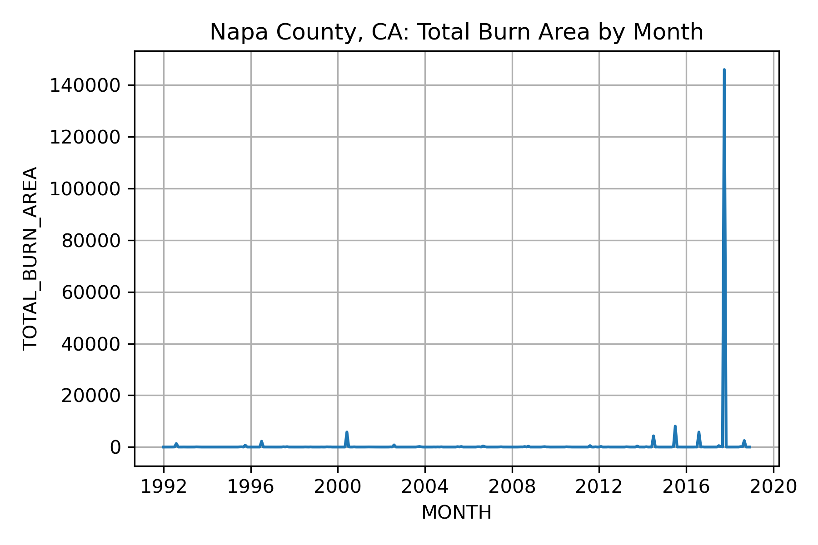
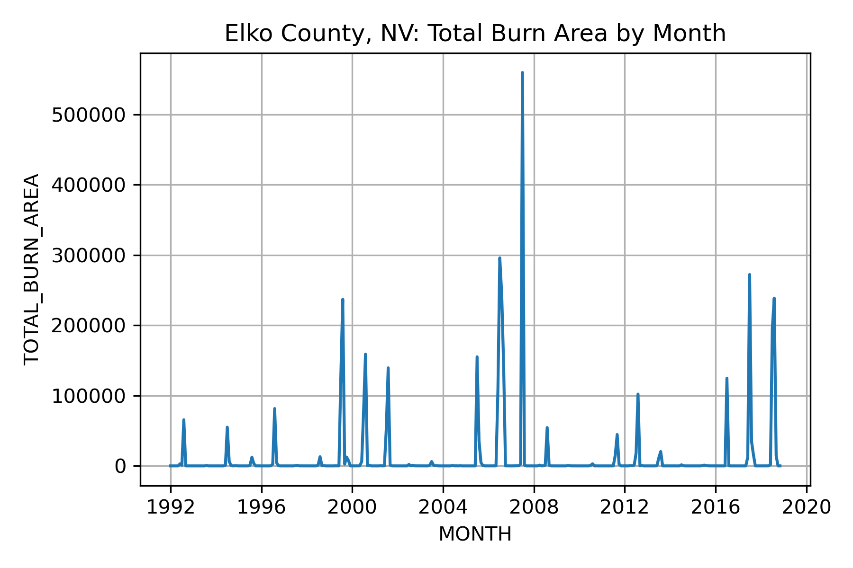
Data Visualization
We use specific counties as examples to make analysis clearer
Napa County, California
Elko County, Nevada
Time Series Plots

Slide 6
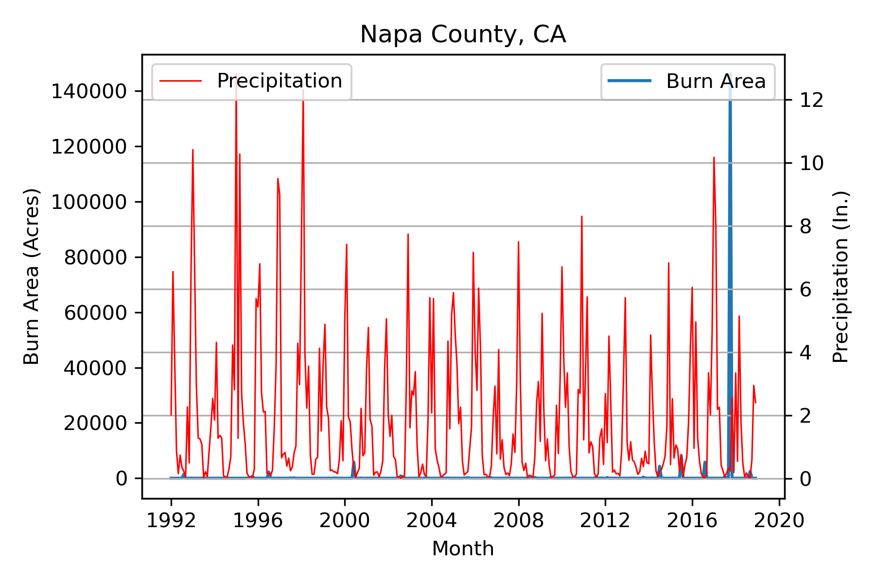
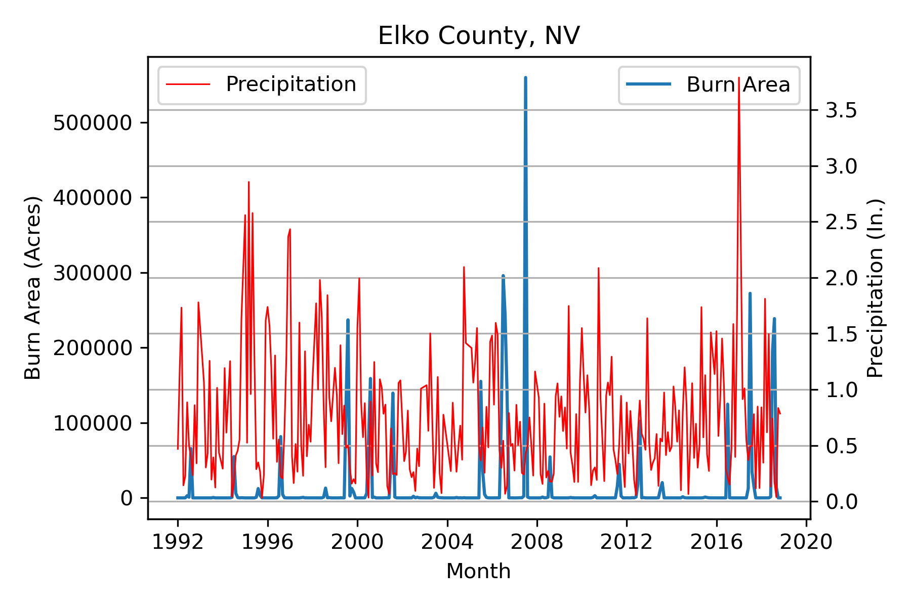
Data Visualization Cont’d
Visualize Precipitation with Burn Area

Slide 7
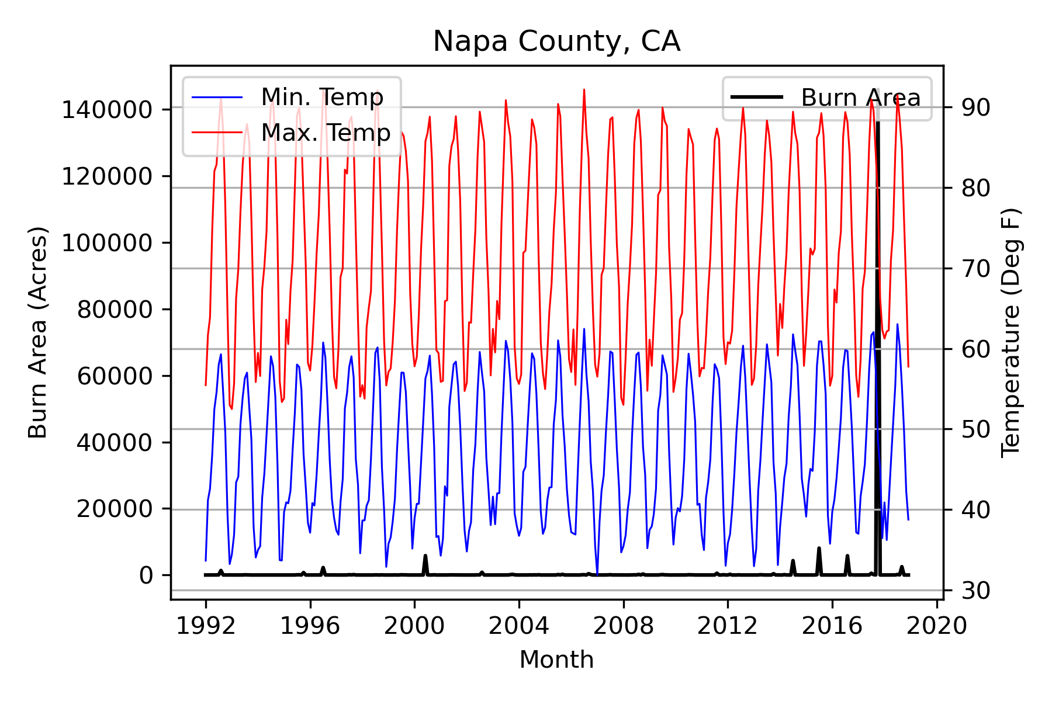
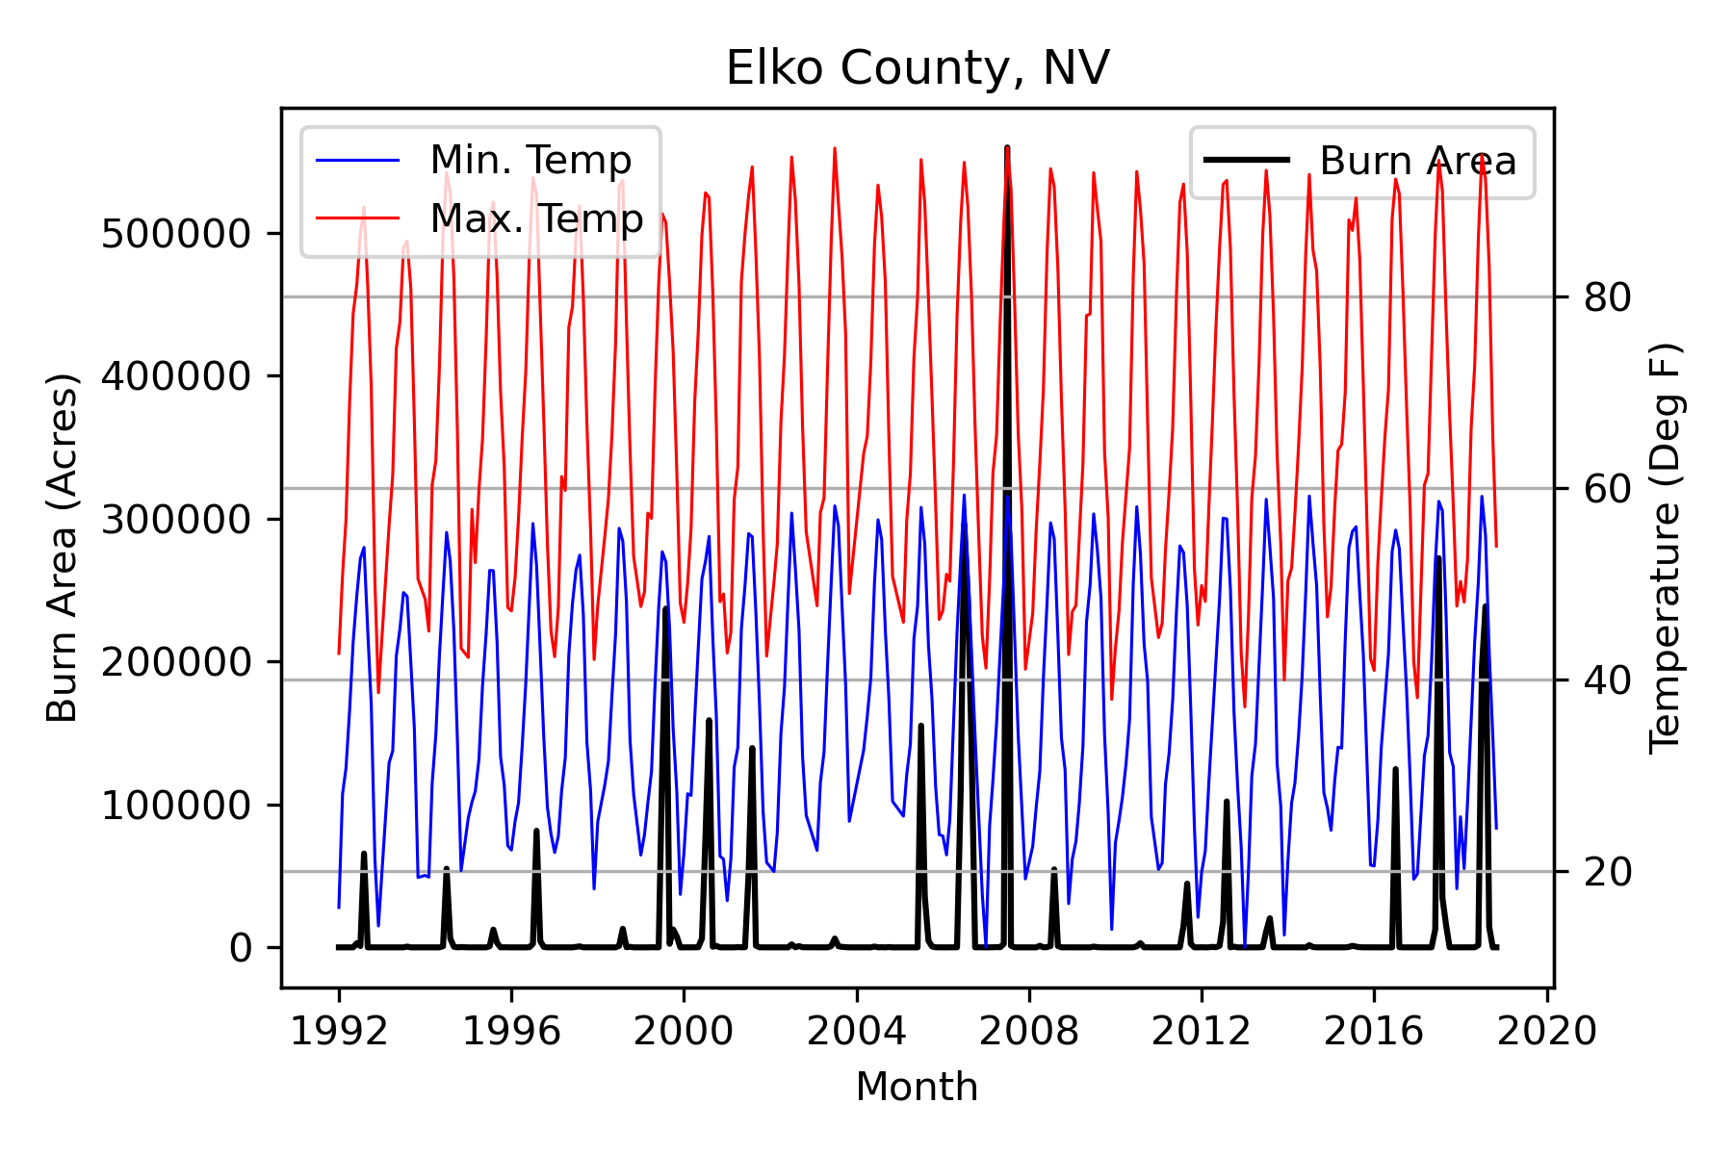
Data Visualization Cont’d
Visualize Temperature with Burn Area

Slide 8
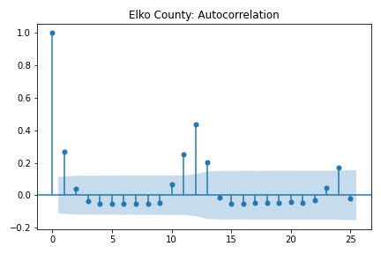
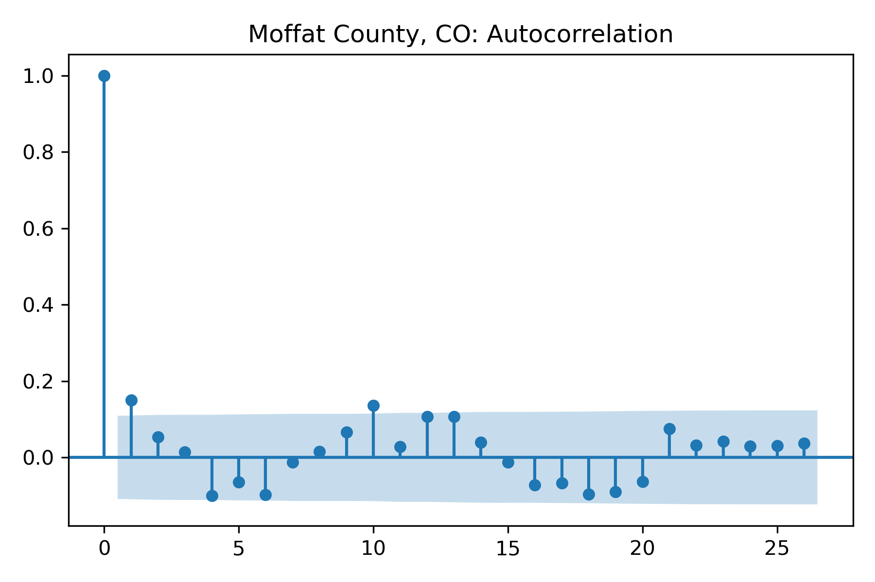
Model Framework
Utilize a time lagged design matrix
This involves lagging burn area, precipitation, and temperature for both immediate lags (i.e., 1,2,3, … periods ago) as well as for annual lags (i.e., 11, 12, 13, 23, 24, 25 periods ago)
Motivated by observed auto-correlation for some counties

Slide 9
Model Framework Cont’d
Include county area
Account for the fact that larger counties typically have more land to burn
Although we did not include Alaska, there are some counties in Alaska with county areas larger than most entire states
Include categorical variables for individual county and state
This may account for varying wildfire containment or prevention policies by county or state as those are likely left up to local governments to determine
This consists of 411 individual counties and 11 states

Slide 10
Model Fitting
Data is separated into training and testing sets chronologically for each county.
That is; 1992-2017 is used for training and 2018 is used for testing
We fit a CatBoost model
Implements the XGBoost algorithm but with better handling of categorical features
Accuracy metrics
Root mean squared error
Mean absolute percent error
Median squared error
Due to some of the outliers and extreme values in the data

Slide 11
Model Accuracy
 | Train | Test
RMSE | 5200.411 | 12171.78
MAPE | 2.09% | 2.14%
Median Absolute Error | 115.51 | 141.62

Slide 12
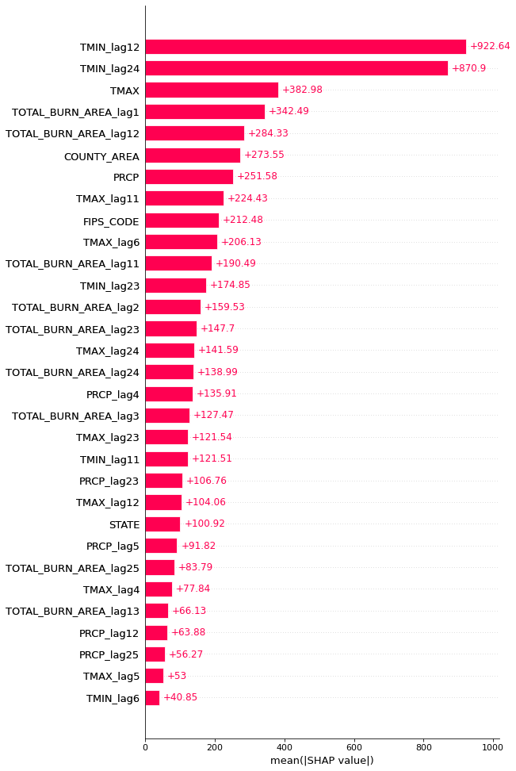
Model Interpretation
Feature Importance
Using Shap values
Weather
Captures the cyclical nature of wildfires and impact of weather on their size
Previous month/year burn area
Indicate the model is capturing the autocorrelation we noticed previously

Slide 13
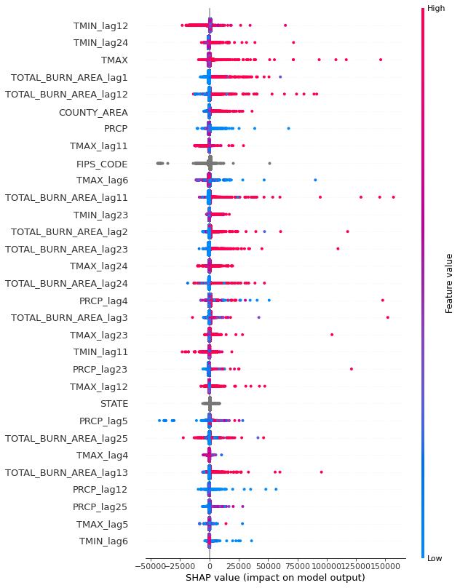
Model Interpretation Cont’d
Feature Impact
Using Shap value per prediction
Generally positive impact from previous month/year burn area
Impacts due to weather are difficult to explain since ‘extreme’ weather is relative to each state/county

Slide 14
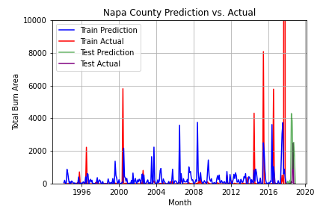
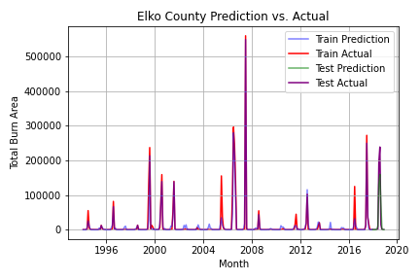
Predictions
Use the model to predict on the train and test sets and plot the results

Slide 15
Conclusions
Using this model, we can generate forecasts for individual counties and their monthly wildfire severity – we would have to forecast precipitation, and temperature so that we would have all our inputs available in the forecast space
A time lagged nueral network may be able to outperform the decision tree-based model but the simplicity of design and interpretability of the tree-based model is highly desirable
A model framework which is truly hierarchical may be able to better model the effects due to the individual counties and states
The extreme outliers are going to be difficult for any model to predict but some Bayesian techniques may be able to assign a probability to such events happening, as, even though they do happen, they are quite unlikely
Notes:
Things to answer:
Introduce the background
Address research question clearly
Stick to the tables/graphs – not the code
Cleaning and preparation – make it clear what I did and why
Give an explanation on the method & introduction to the method – provide an algorithm (simple)
Model output – explain the parameter settings and the results
Summary of results and discussion (limitations and possible future improvements)

